Slide 1

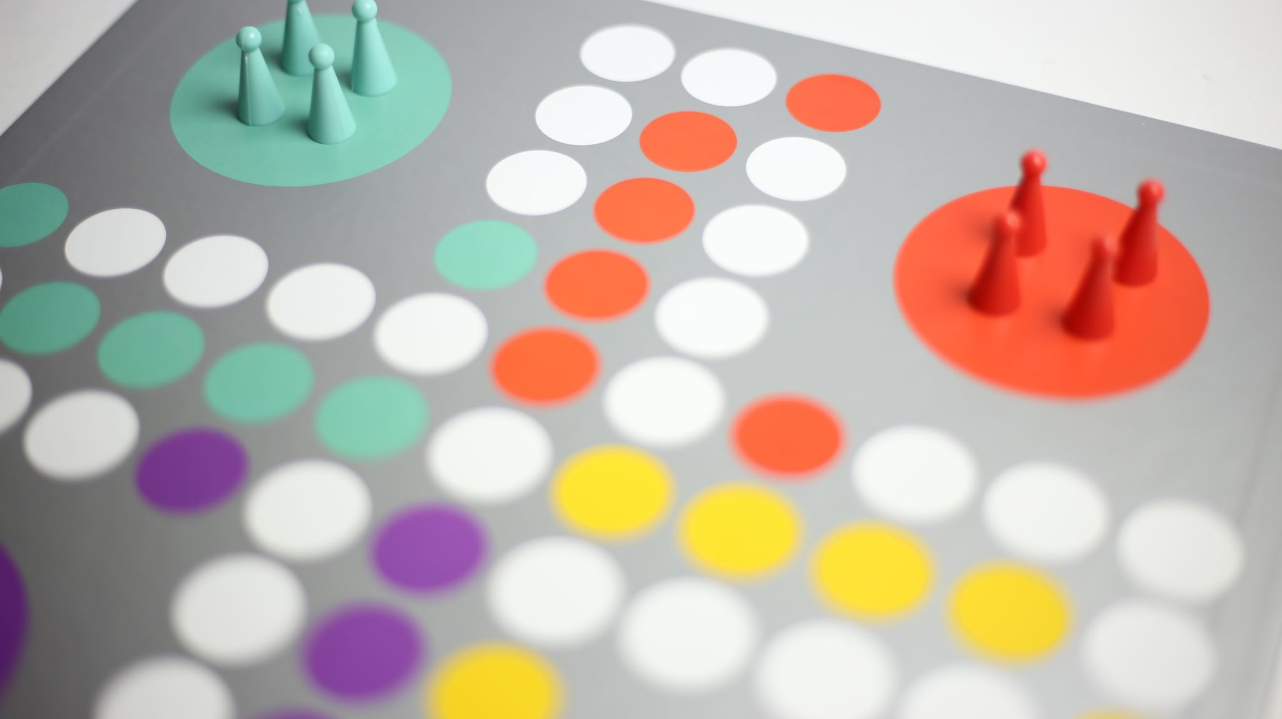

UNIVERSITY GAME ROOM DASHBOARD
GROUP-10
Digvijay Hethur Jagadeesha - 212619721
Jateen Joharapurkar - 212620553
Ashwini Sudheerkumar - 212641730
CSC 541 – Advanced Software Engineering
Project Proposal
Professor: Dr. Bhrigu Celly

Slide 2

Project Overview
Purpose:
- Develop a Games Room Dashboard to streamline activities.
- Enhance user experience and operational efficiency.
- Facilitate event planning and management.
Scope:
- Software development, testing, deployment, and maintenance.
- Integration of advanced technology stacks.
- Implementation of user-centric design principles.
- Real-time data tracking for interactive functionality.
Considerations:
- Replace Excel sheets for shift reports.
- Automate tracking of student activities and transactions.
- Calculate card and cash totals for each shift.

Slide 3

Stakeholder Analysis
Students:
Interests: Utilize the user-friendly dashboard for checking game availability and registering for events.
Expectations: Seamless and efficient access to game-related information and event registration.
Game Room Attendant:
Interests: Check in and check out customers, collect payments, keep track of transactions, monitor games and events
Expectations: Ensure smooth operation of the game room and accurate record-keeping.
Business Operation Manager:
Interests: Monitor daily and weekly reports to keep all stakeholders accountable.
Expectations: Maintain transparency and efficiency in daily operations.

Slide 4
Stakeholder Analysis
Building Manager
Interests: Ensure the game room operation and maintenance aligns with the university’s objectives.
Expectations: To access reports on day closure for transaction verification.
Project Team:
Project Manager : Oversees and coordinates the entire project.
Developer : Responsible for software development.
Tester: Ensures the quality and functionality of the developed software.
Expectations: Collaborate effectively to deliver a successful and well-functioning games room dashboard.

Slide 5

Requirement Gathering
Helps us to understand what the stakeholders expect from us
Conducted interviews with game room attendants and students that use the game room to learn more about the enhancements they would like to see.
Challenges Encountered: Finding a balance between the project’s scope and the required features to prevent scope creep.

Slide 6

Software Requirements
Technology Stack: Java 21, Virtual Threads, Spring Boot, GraphQL, REST API, OAuth Authentication with JWT Tokens, Kafka, NoSQL, Caching, CAT tool, CockroachDB, Kubernetes (Rancher), Docker, Gradle, Spock, Cron Jobs.
Front End Development: Use React (latest version) to develop a landing page, login page, dashboard, data manipulation page for Excel, and a report access page for documents stored in Dropbox.

Slide 7

Software Requirements
Functional Requirements: User authentication, dashboard features (add, edit, update, delete), financial report generation.
Non-Functional Requirements: Performance monitoring with Splunk, Datalog, Grafana; Configuration management with CAT, Terraform.
Prioritized Features: Landing page, authentication, dynamic dashboard functionalities, integration with Dropbox for report access.

Slide 8
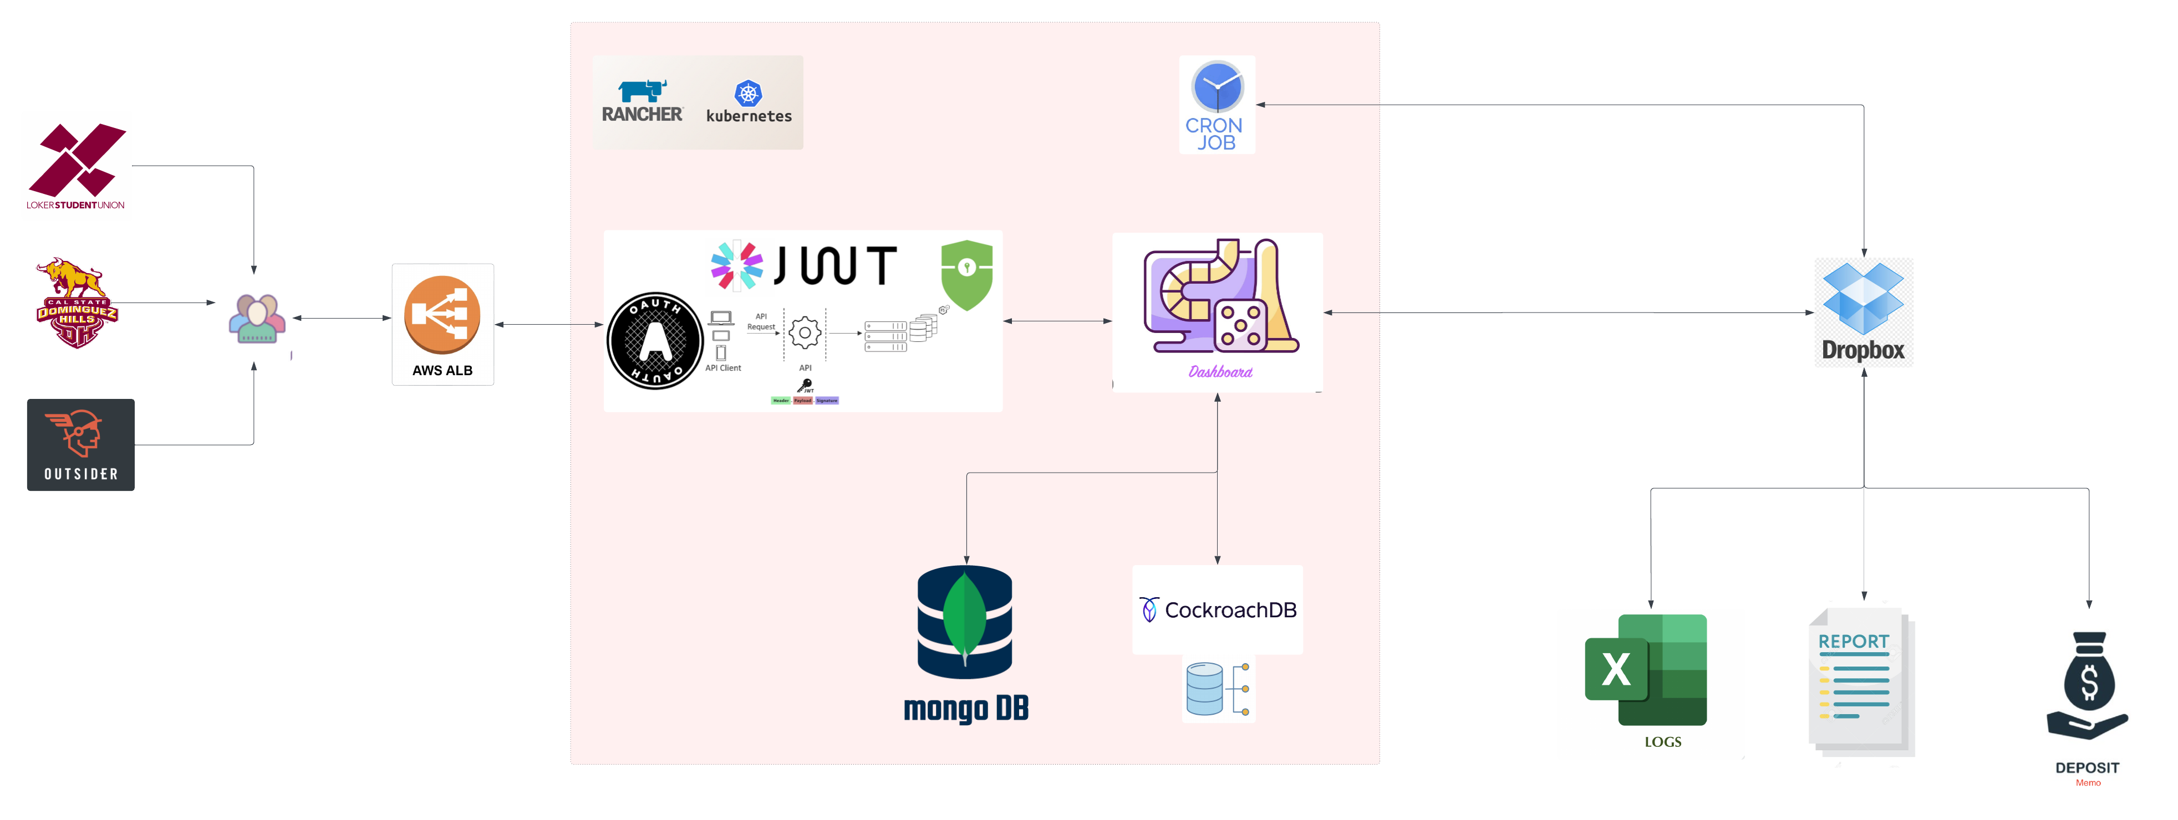
Architecture Overview

Slide 9
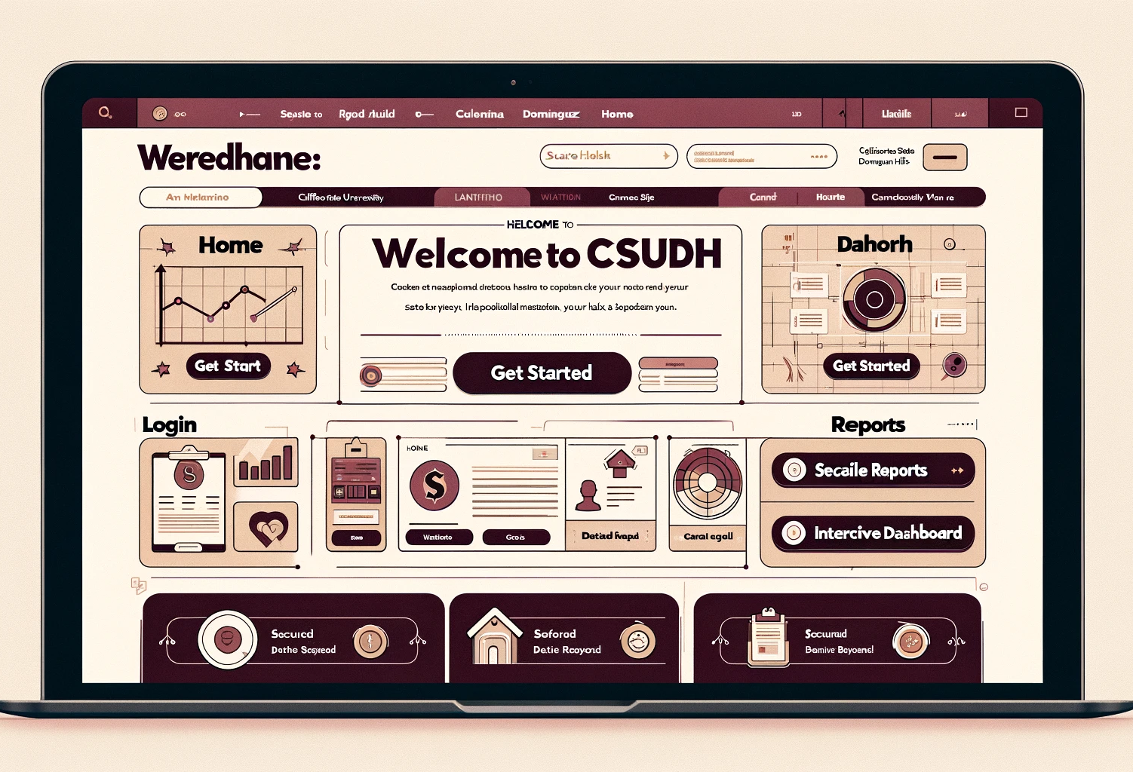
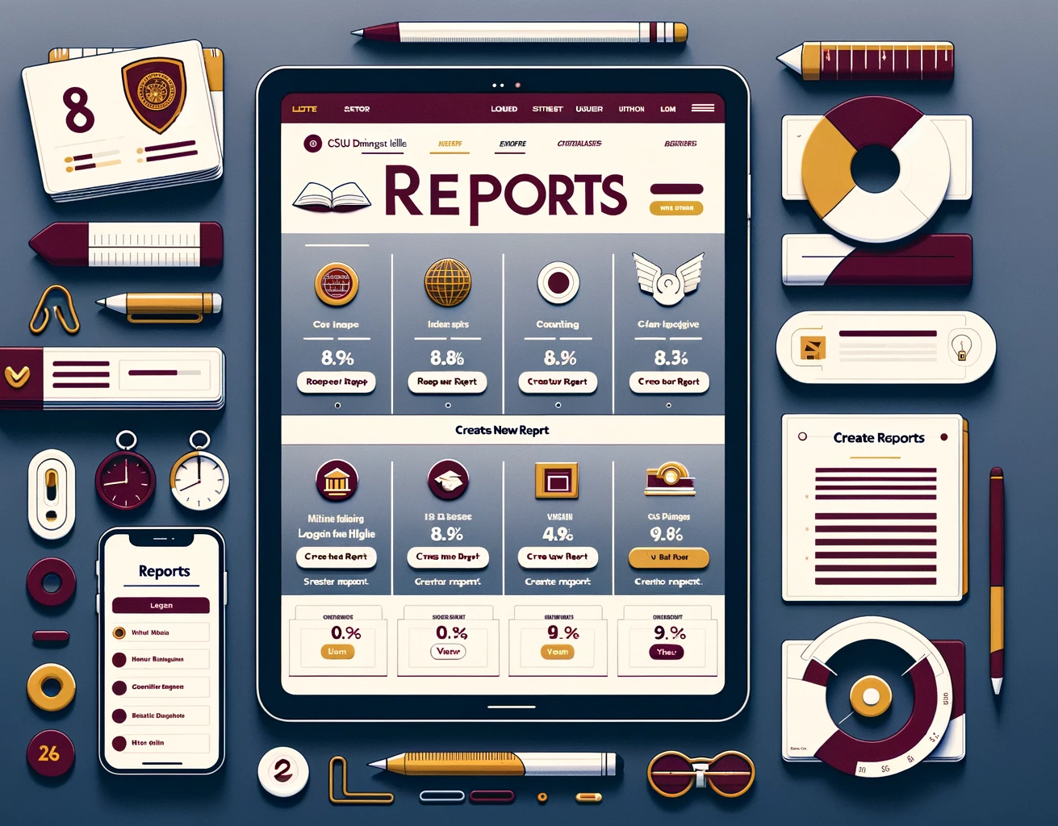
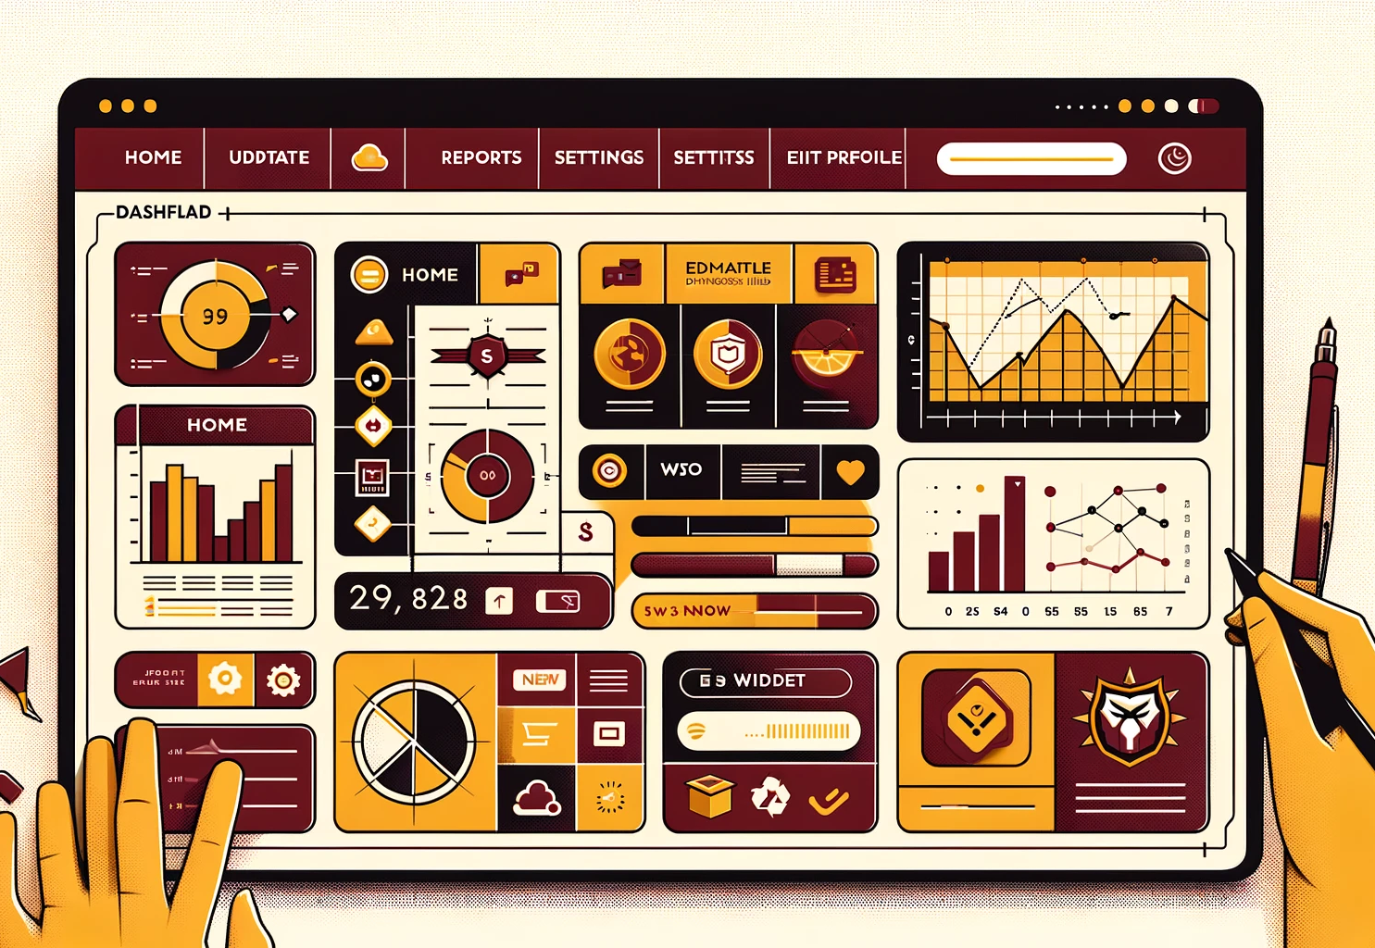
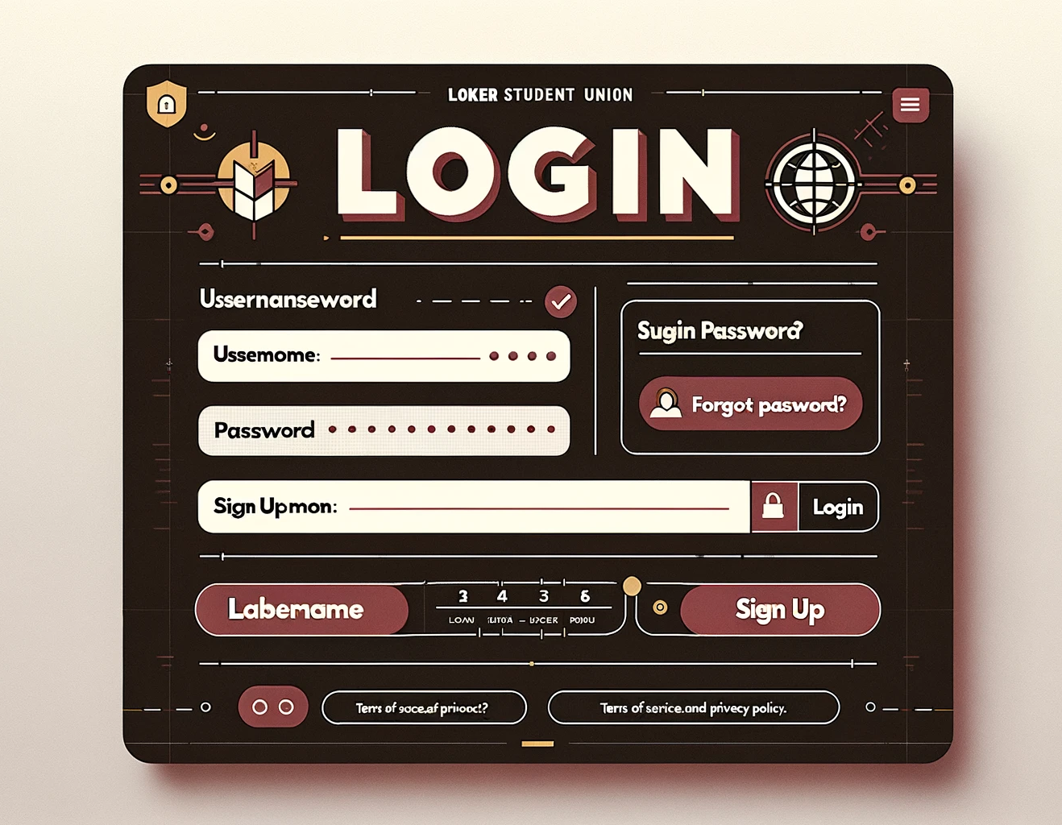
User Interface - Landing Page - Login Page - Dashboard - Reports

Slide 10

THANK YOU

